Slide 1


AN ORAL PRESENTATION ON STUDENT INDUSTRIAL WORK EXPERIENCE SCHEME (SIWES) UNDERTAKEN AT: GIS KONSULT (No 44, ADEYI AVENUE BODIJA, IBADAN, OYO STATE)
BY OFOBUTU ABIODUN EMMANUEL JANUARY 2023

Slide 2
OUTLINE
ABOUT PLACE OF ATTACHMENT: GIS KONSULT
HIGHLIGHT OF WORK DONE AND EXPERIENCE GAINED
CONCLUSION
CHALLENGES FACED
RECOMMENDATION

Slide 3
INFORMATION ABOUT GIS KONSULT LIMITED
GIS KONSULT Ltd is a private GIS company owned and managed by Mr. David Afolayan, specialized in offering simple solutions to complex spatial problems by leveraging on Information Technology and Geographic Information Systems. The company is dedicated to helping provide insight, intelligence, and information that decision-makers can use to make smart decisions - be it governmental or non-governmental bodies.
GIS KONSULT Ltd was established on the 28th November,2007 with the registration number RC720071.

Slide 4
WHAT THEY DO
GIS KONSULT LTD provides a wide range of GIS solutions for end-users. Some of these solutions that the company produces include:
Mapping and Cartography
Training and Capacity Building
Project Development and Management
Spatial Data Acquisition and Analysis
GIS Infrastructure and Operations Hosting
Asset monitoring and security Management

Slide 5
PROJECTS UNDERTAKEN/ ENGAGED IN AND SKILLS ACQUIRED
Satellite imagery acquisition
Georeferencing of Image Maps for further analysis using different methods
Digitizing of features like roads, streams, etc using Arcgis and Arcgis online
Cartography.
Biodiversity Survey
Extraction of contours using Google earth pro
Flood Simulation mapping
Surface analysis and spatial analysis
Generating stream network and watershed

Slide 6
GENERATING A CONTOUR MAP USING GOOGLE EARTH PRO FOR OKE-ERO LOCAL GOVERNMENT AREA, KWARA STATE

Slide 7
INTRODUCTION
Contour lines serve as fundamental component of topographic maps and several important purposes in GIS and cartography. The main purposes of contour lines are as follows:
1. Representation of Elevation: Contour lines depict the shape and elevation of the land surface.
2. Visualization of Slope and Steepness: Contour lines provide a visual representation of slope and steepness.
3. Determination of Watershed Boundaries: Contour lines play a crucial role in delineating watershed boundaries. Watersheds are areas of land where all precipitation and runoff flow into a common outlet, such as a river or lake
4. Estimation of Relief and Terrain Visualization

Slide 8
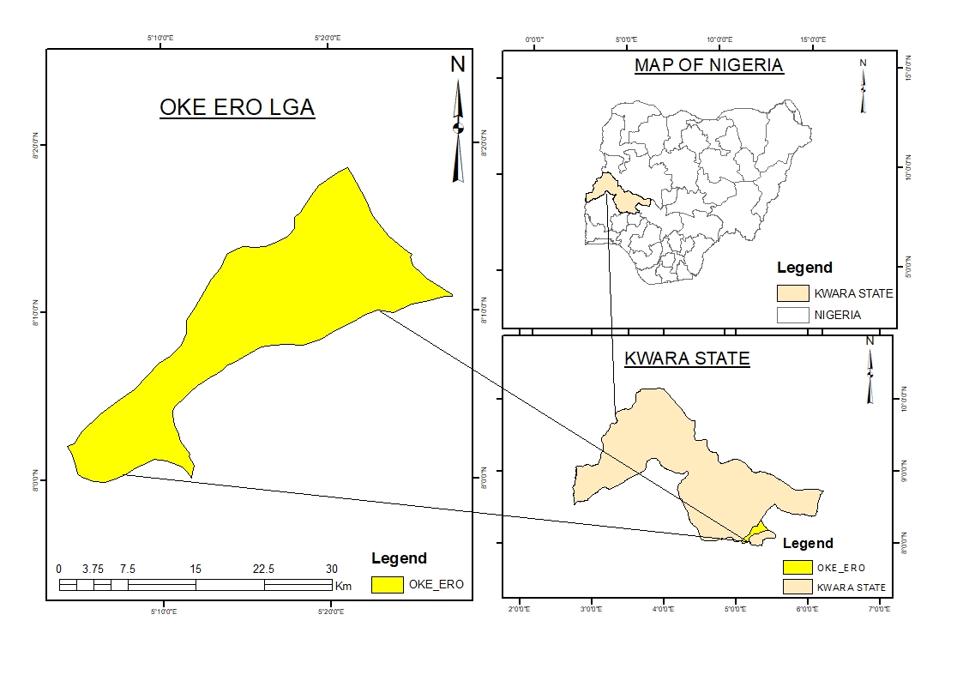
Oke Ero is one the 16 Local Government Area in Kwara State, Nigeria. Its headquarters are in the town of Iloffa. Other Major towns in Oke Ero are Odo-Owa, Idofin, Ekan Nla, Ayedun,Erin Mope, Egosi, Imode, Idofin Odo-Ase, Kajola and Ilale. Latitude 8° 5' 36" N and longitude 5° 8' 32" E
STUDY AREA

Slide 9
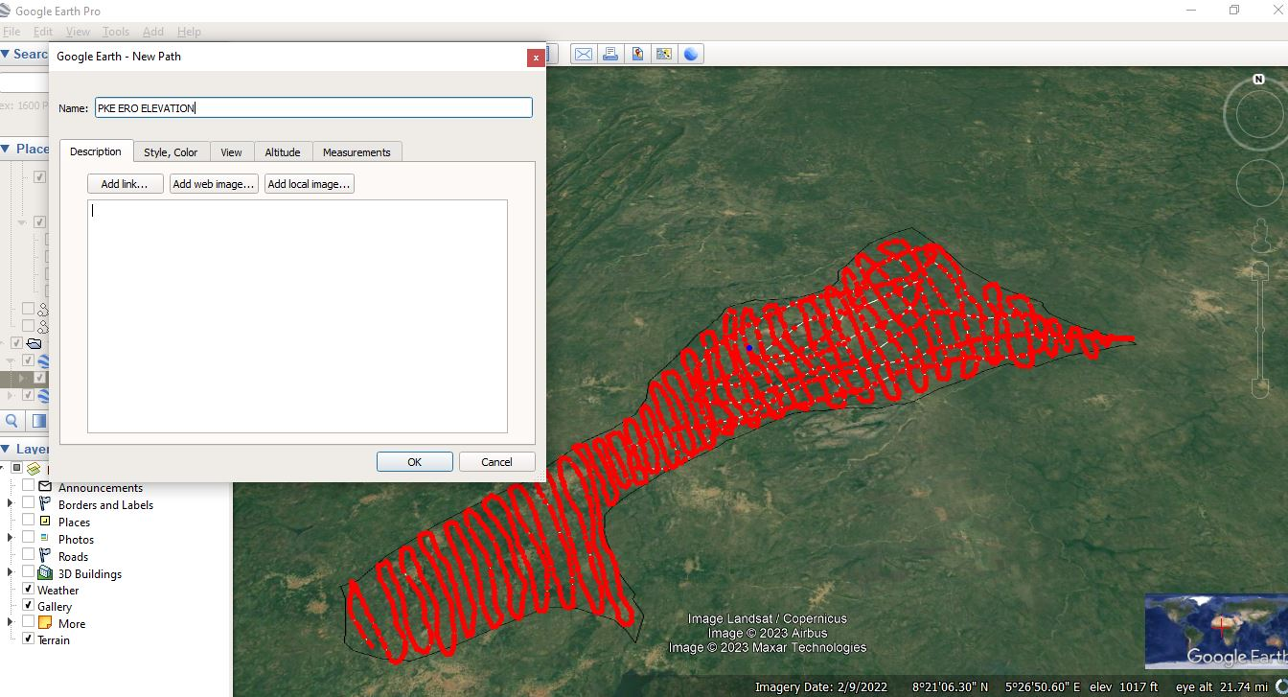
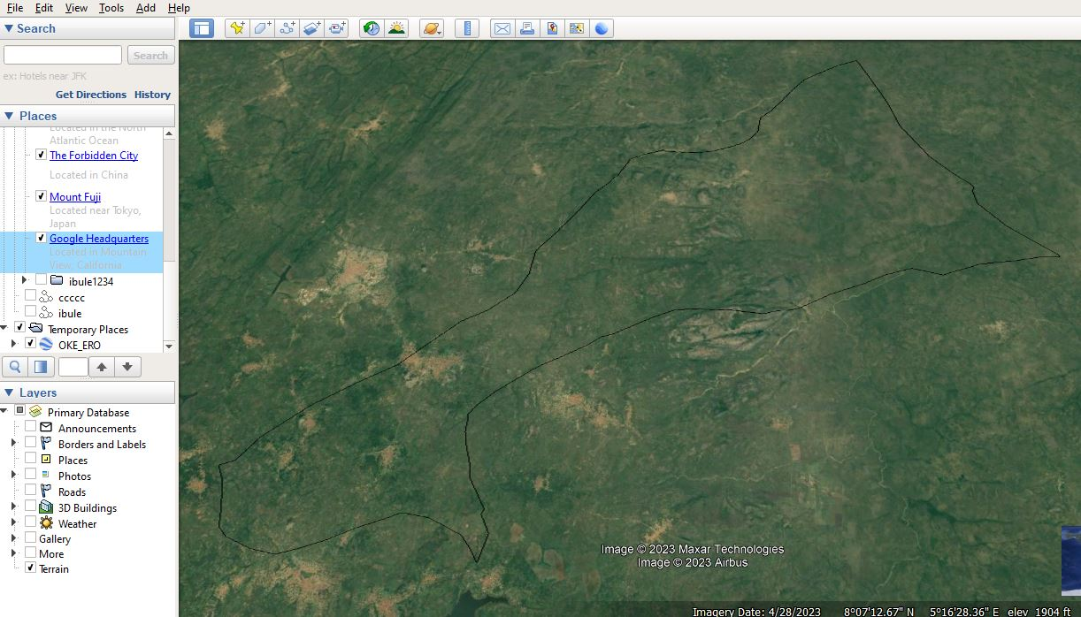
On the Google Earth Pro:
Import the kml shapefile of the area of interest
Click on the "Add Path" button.
Draw the path along the contour line you want to extract.
Right-click on the path and select "Save Place As".
Choose a file format and a location, the format is kml.
Click "Save".

Slide 10
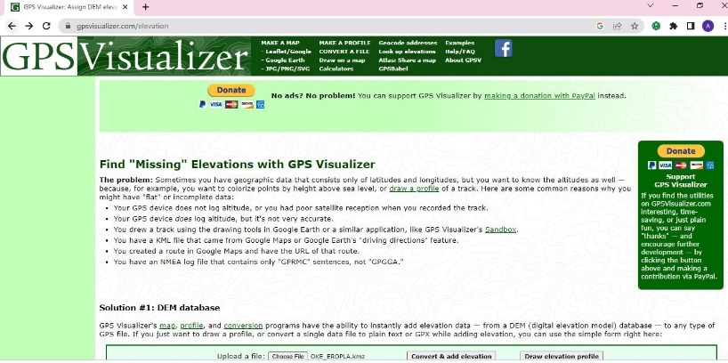
CONVERTING THE KML FILE TO GPX
Import the saved KML file to www.gpsvisualizer.com/elevation
This website have the ability to instantly add elevation data — from a DEM (digital elevation model) database to any type of GPS file.

Slide 11
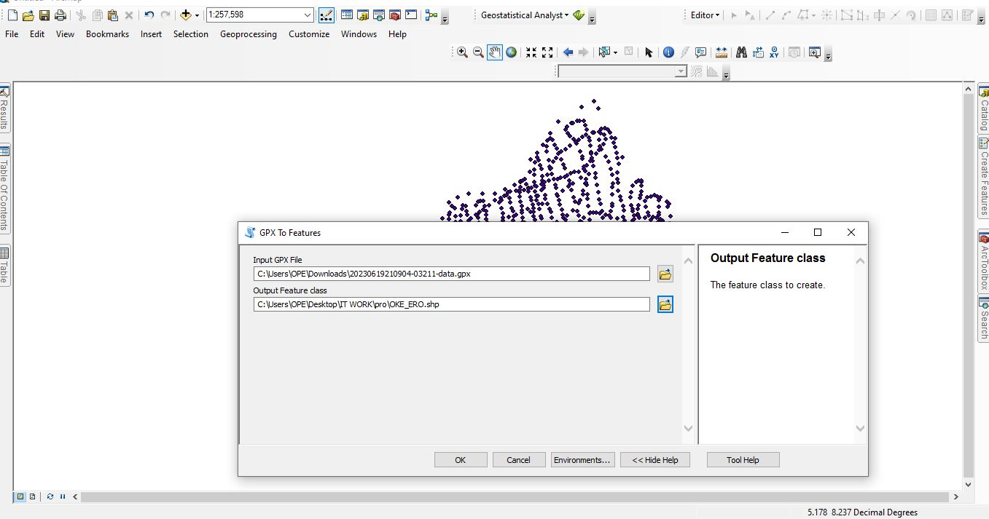
On the Arcgis, convert the gpx file downloaded from the gps visualization website to features using “gpx to features” tool
By converting GPX files to features in ArcMap, it gives full advantage of the robust spatial analysis capabilities, data integration, and visualization options available in the ArcGIS

Slide 12
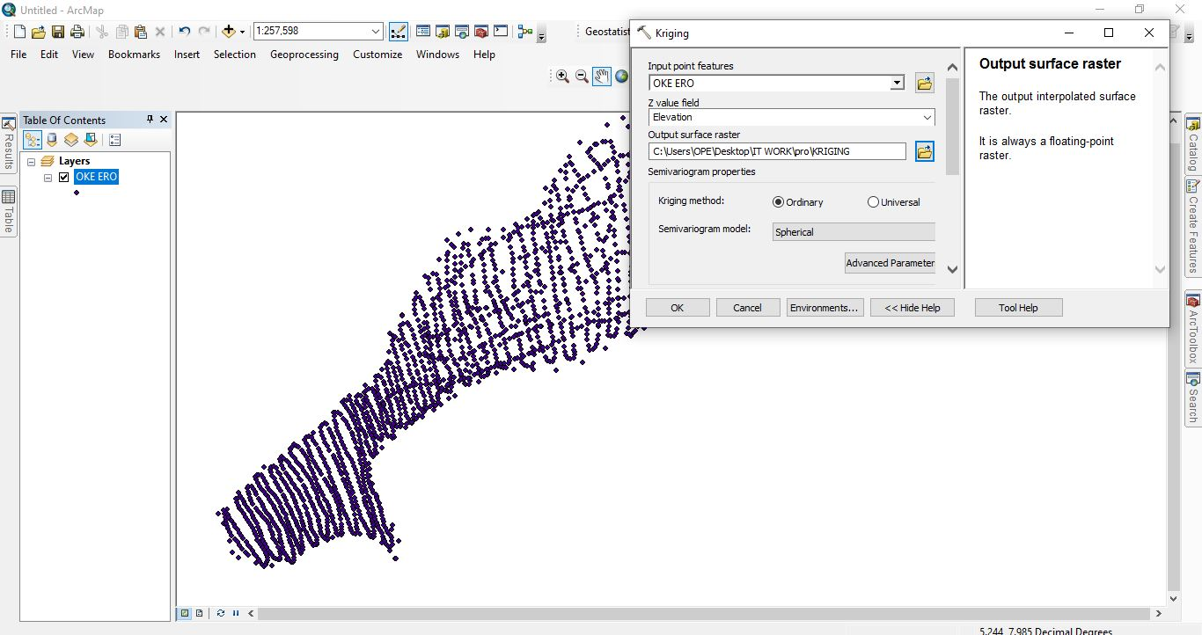
Interpolating the data to create a Digital Elevation Model(DEM)
Using interpolation tools: KRIGING to estimate elevation values at unmeasured locations based on known elevation data points

Slide 13
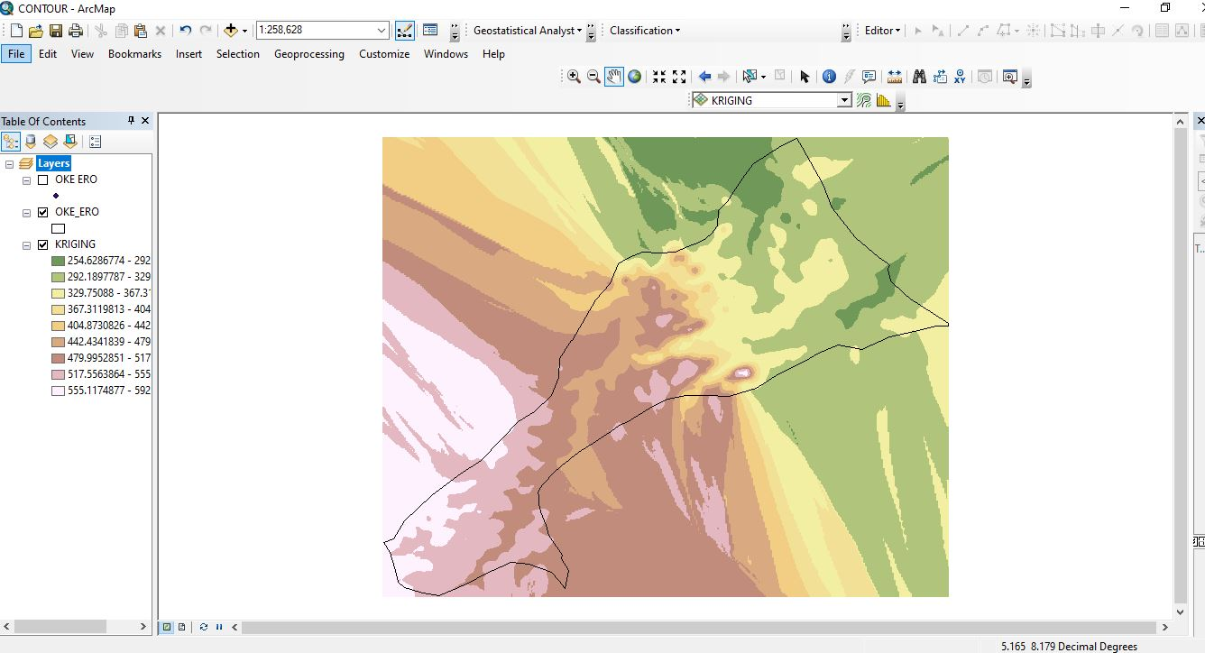
Picture showing the result of kriging interpolation

Slide 14
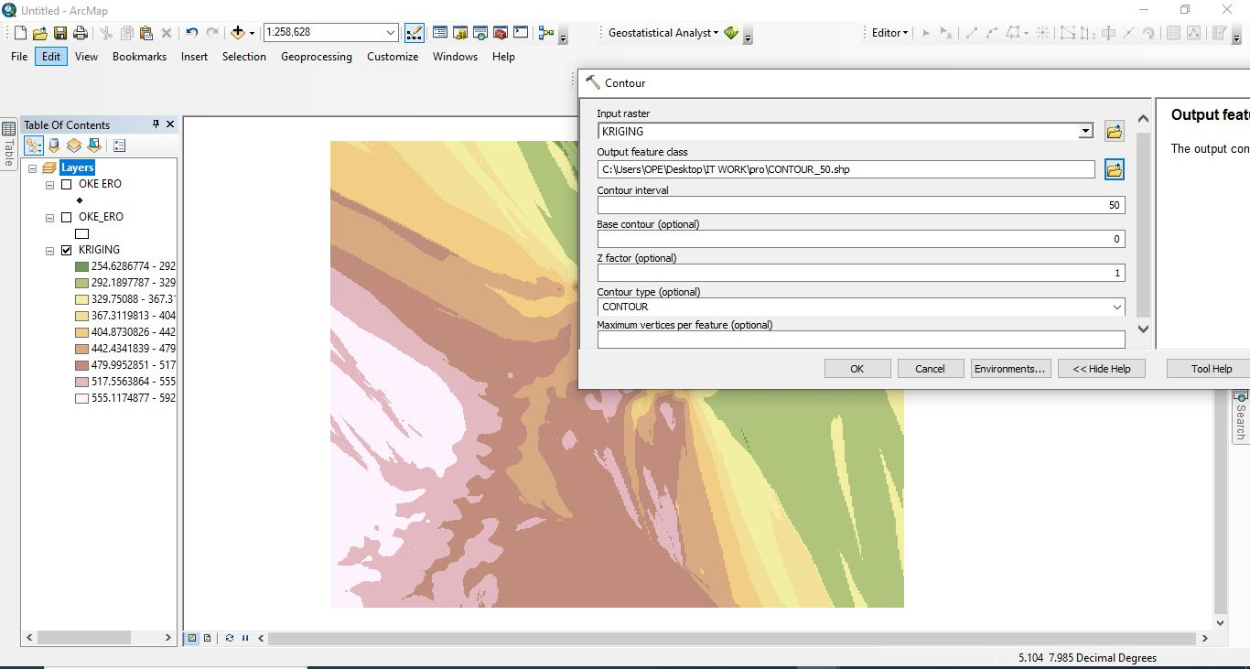
Using the "Contour" tool available in the Spatial Analyst extension to generate contour lines.
the contour interval refers to the vertical distance between adjacent contour lines on a contour map
The contour interval used is 50m to show the interval, or distance, between contour lines.

Slide 15
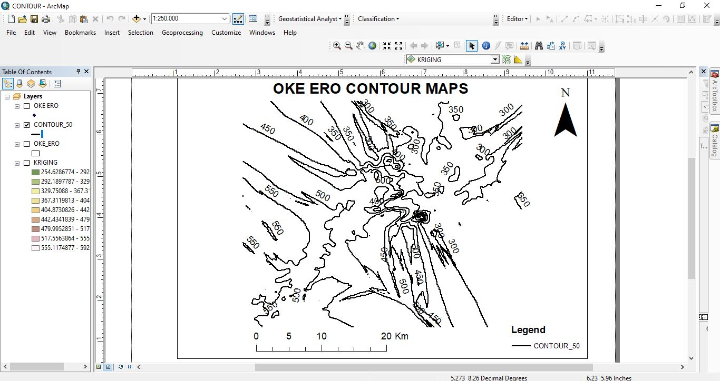
Picture showing contour lines at 50 meters contour interval

Slide 16
In summary,
Contour lines are essential tools in GIS and cartography, providing information about elevation, slope, relief, drainage patterns, and more. They enable us to interpret and understand the terrain's characteristics, plan routes, make informed decisions, and perform various analyses related to land use, engineering, and environmental management.

Slide 17
CONCLUSION
Having completed the Student Industrial Work Experience Scheme (SIWES), I have gained valuable first-hand Industrial based practical experience of what the Remote Sensing and GIS industry entails.
The industrial training programme has bridged the gap between the theoretical and practical knowledge I already had with the skills required in the work environment.
The SIWES programme has also served as a life experience as I was able to gain some relevant skills that I know will be useful to me not only in the working environment.

Slide 18
CHALLENGES FACED
As is with anything worth doing at all, I faced quite a few challenges before and over the course of the Student Industrial Work Experience Scheme (SIWES). Some of which includes:
Difficulty in finding placement
Cash scarcity during cashless policy
High cost of transportation from residential area to GIS consult.

Slide 19
RECOMMENDATION
Here are some recommendations that I believe can be useful in improving the Student Industrial Work Experience programme.
The department should capitalize on the places that previous sets have done their SIWES programme and establish a working relationship with them. This way, it will be far easier for students to easily secure Industrial Attachments when needed.
SIWES is a great initiative and it should be properly monitored by the institution to ensure that students are properly learning what they need to know about their industry.
IT is stressful, time consuming, and most importantly money consuming. ITF should therefore assist student by providing student with stipends that can support them during the internship.
GIS is quite diverse and touches different areas, so I am indulging all students to explore the application of GIS in different field of study to find what they find best for themselves.

Slide 20

THANK YOU FOR LISTENING

